Slide 1

Anona ai
Gvahim-Cyber final project

Slide 2
“למה לסבך סיסמאות שעמדו במבחן? אין איש מאזין להן, לא הגבר ולא האישה, כי הם מקשיבים בעיקר לקול המשמיע אותן”
-אלבר קאמי מתוך המיתוס של סיזיפוס

Slide 3
Chrome Extension
Big Data
Machine Learning
WhatsApp Web
Anona AI
Google Firebase
User Behavior based Security

Slide 4
Profiling
Chrome Extension
Data Fishing
Push
Data
Authentication
Google Firebase
Database
Use
Alert
User
Data
Generate Features
Machine Learning
Train Algorithm
Update
Detecting Security Break
Database

Slide 5
Chrome extension
Fetching keystrokes from WhatsApp Web - Profiling & Securing
Real time keystone data processed into Database (firebase)
Allow sign up / in / out of ANONA AI
Implemented in JavaScript

Slide 6
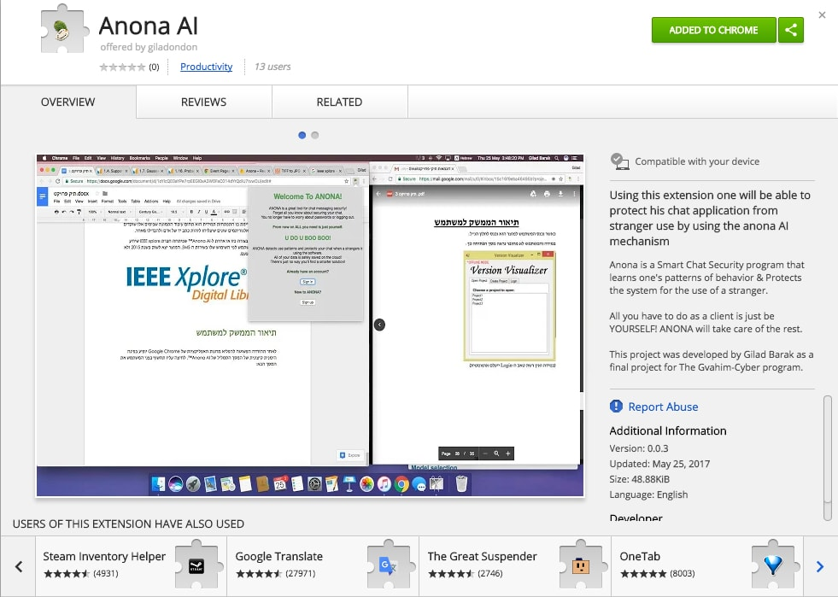
look it up - chrome web store

Slide 7
Google Firebase
User Authentication (Email&Password)
Big Data Handling & Processing (Real Time DB)
Google Firebase - Json based DB

Slide 8
Authentication
Sign up or Sign in based on Email & Password.
Prevent user duplication.
Allow access to Database for signed in user.

Slide 9
database
Real Time Database
Json Style Database
Multi-User database handling
Key codes (unicode) & Time Stamps

Slide 10
Machine Learning
Using scikit-learn & karas: machine learning python

Slide 11
Collect Data From User
Machine Learning Algorithm
Train Algorithm
New Samples
Predict

Slide 12
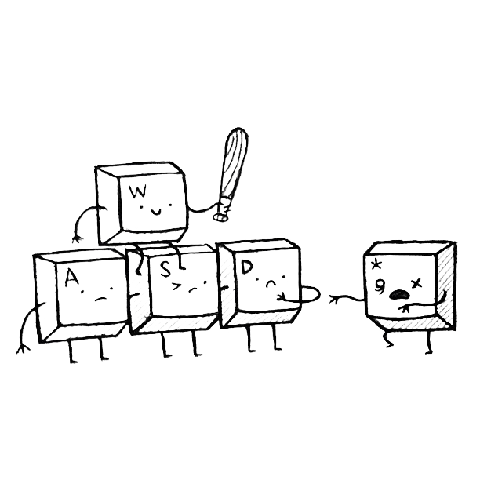
what makes one unique?
Typing pace
Use of Backspaces
Use of Punctuation Marks
Language Shift (HEB-ENG)

Slide 13
Classification
clustering
VS.
Identifying to which category an object belongs to.
Supervised Learning
Automatic grouping of similar objects into sets.
Un-Supervised Learning

Slide 14
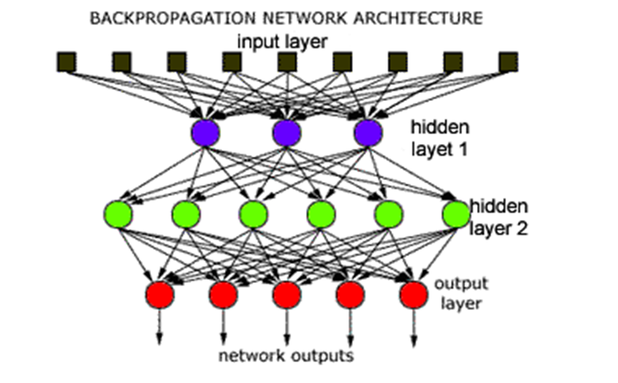
neural network

Slide 15
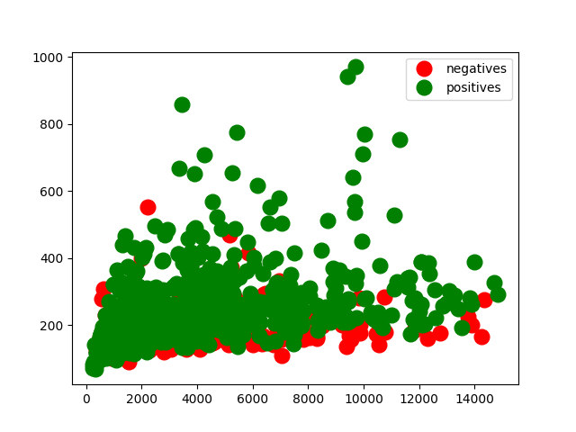
data problem

Slide 16
Now let’s dive into some code
open trainTry.py

Slide 17
“tanh" or hyperbolic tangent function
In mathematics, hyperbolic functions are analogs of the ordinary trigonometric, or circular functions. the points (cosh t, sinh t) form the right half of the equilateral hyperbola.

Slide 18
Rmsprop
RMSprop is an unpublished, adaptive learning rate method proposed by Geoff Hinton in Lecture 6e of his Coursera Class.
Basically any optimizer out there crave to optimize the neural network predictions.
Optimizers Visual Comparison

Slide 19
Profiling
Chrome Extension
Data Fishing
Push
Data
Authentication
Google Firebase
Database
Use
Alert
User
Data
Generate Features
Machine Learning
Train Algorithm
Update
Detecting Security Break
Database

Slide 20
while working on anona ai

Slide 21
And now - The DEMO

